Slide 1
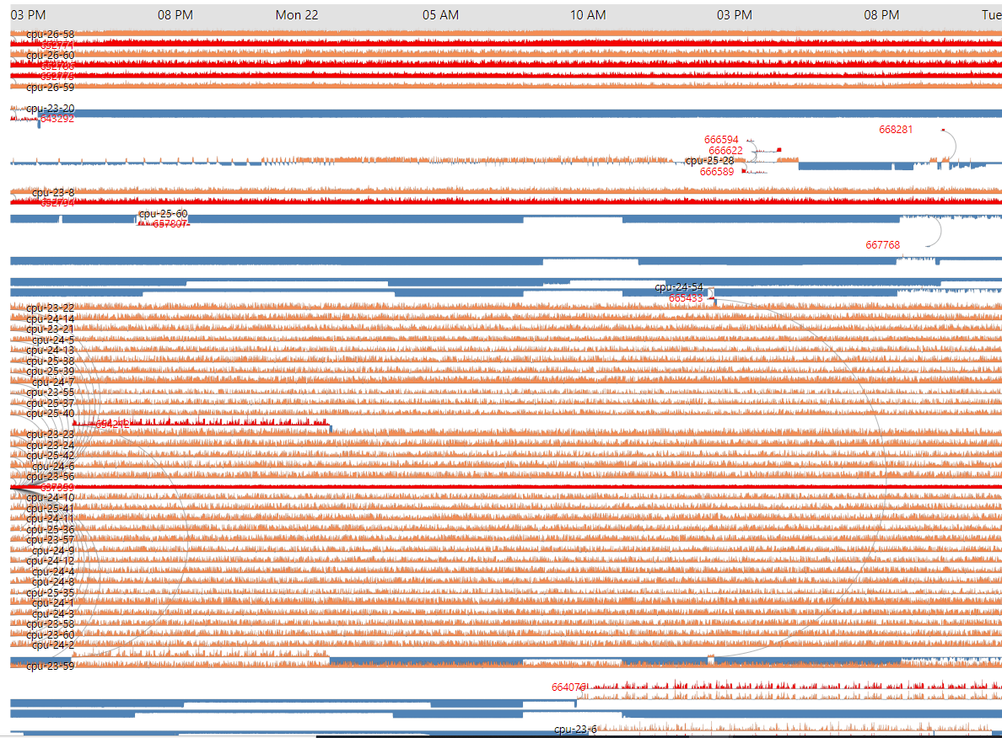
Job Power
Weekly report

Slide 2
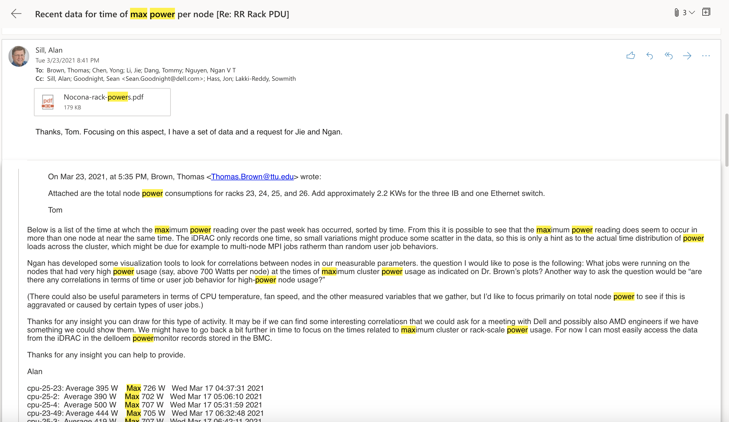

Slide 3
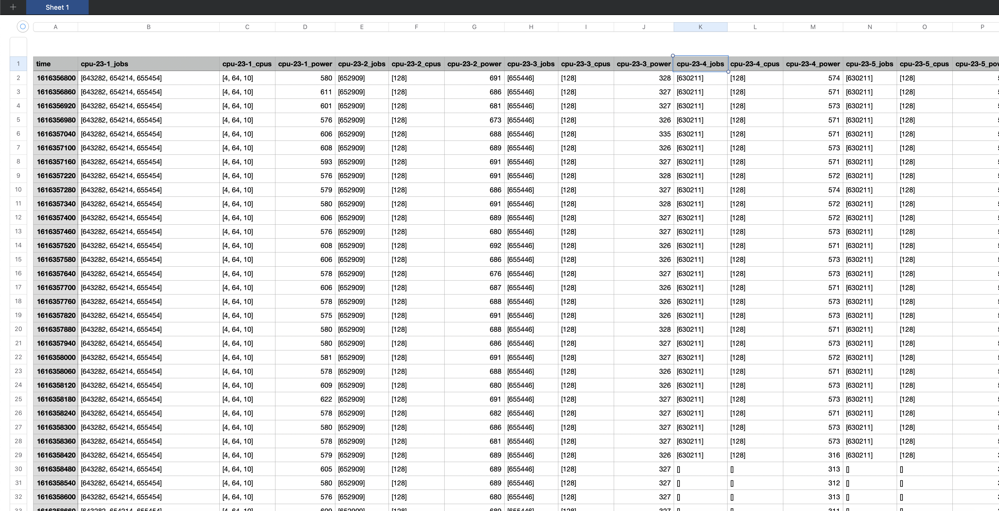
From Mar 21, 2021 15:00pm to Mar 23,2021 => 2881 timesteps (~2 minutes interval)

Slide 4
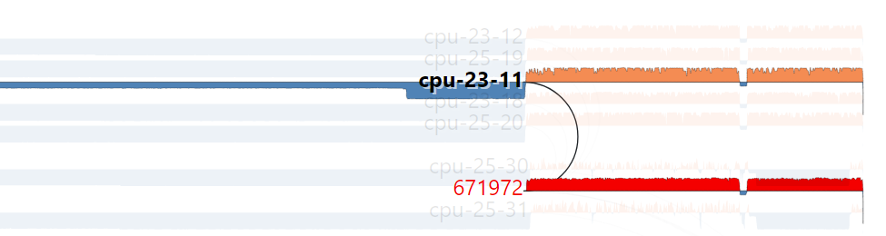
https://idatavisualizationlab.github.io/HPCC/JobPower/index.html
Power Stream
compute
The link is drawn when jobs start
Job
Orange: above 650 watt
Blue: below 650 watt

Slide 5
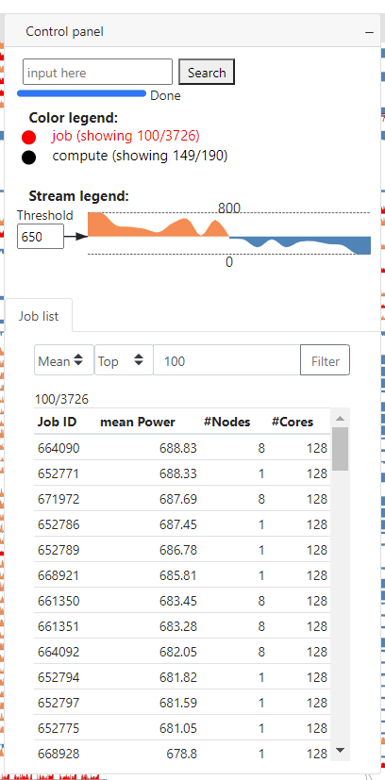
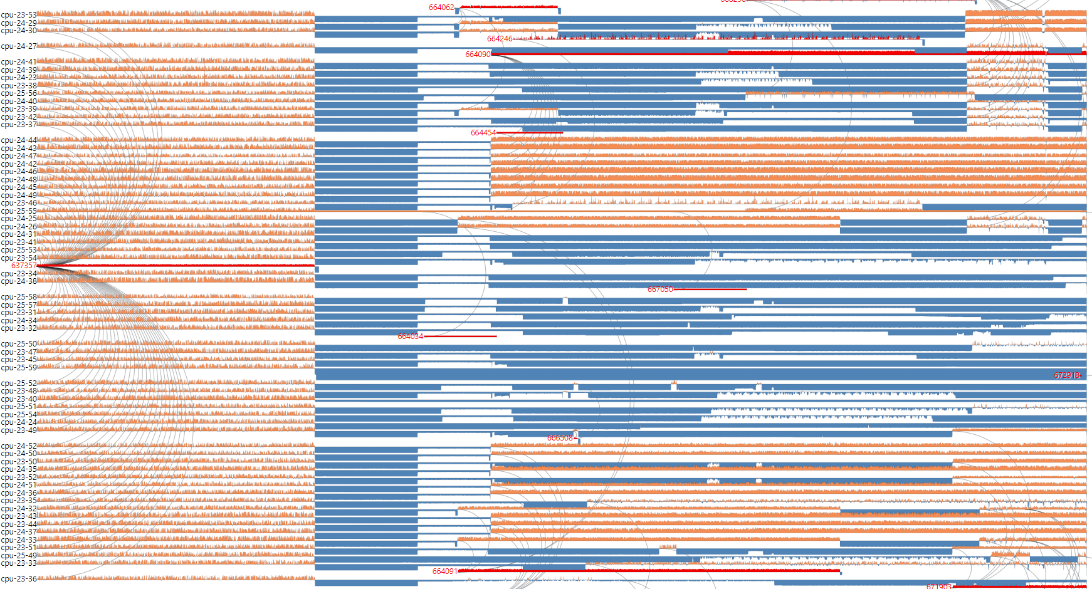
Job Power
Top 100 high power jobs

Slide 6
Job Power
The power reduce as soon as the job finished

Slide 7
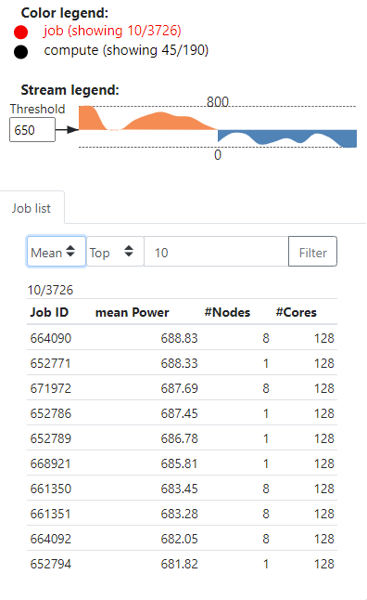
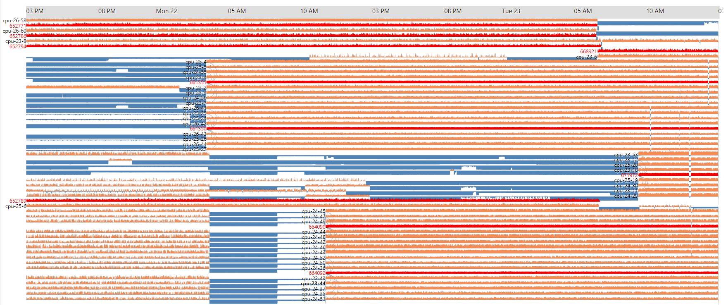
Job Power
Top 10 high power jobs

Slide 8
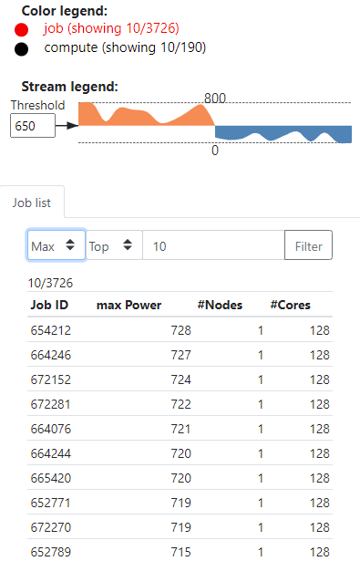
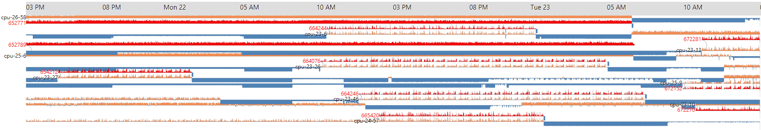
Job Power
Top 10 high power jobs

Slide 9
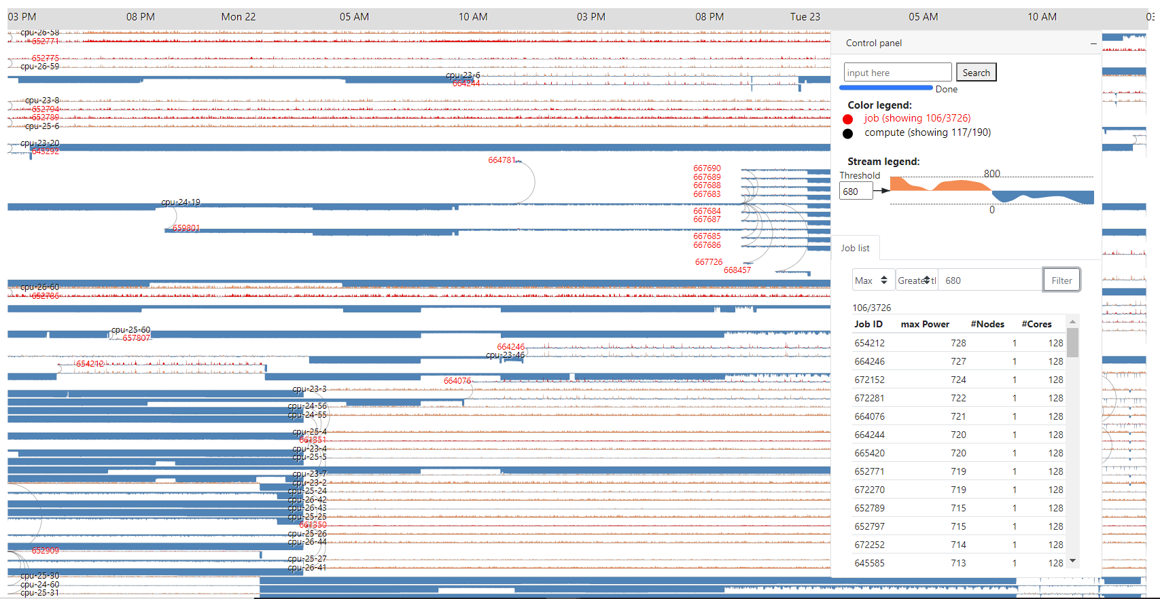
Job Power
List of job has power > 680 watt

